Slide 1
Digital Portfolio
STUDENT NAME: ALEX J
REGISTER NO AND NMID: asunm1703222410118
DEPARTMENT: B.Sc(COMPUTER SCIENCE)
COLLEGE: AKSHEYAA COLLEGE OF ARTS & SCIENCE
(UNIVERSITY OF MADRAS)

Slide 2
PROJECT TITLE
STUDENT DIGITAL PORTFOLIO

Slide 3


AGENDA
Problem Statement
Project Overview
End Users
Tools and Technologies
Portfolio design and Layout
Features and Functionality
Results and Screenshots
Conclusion
Github Link
3/21/2024 Annual Review

Slide 4

PROBLEM STATEMENT
Traditional resumes are static and limited.
Difficulty in dynamically showcasing projects to a global audience.
Recruiters need a centralized, engaging way to evaluate candidates.
Need for a professional, easily updatable personal branding tool.

Slide 5

PROJECT OVERVIEW
A responsive, multi-section website for my professional identity.
Primary Goal: To create a dynamic portfolio communicating my
skills and projects.
Serves as an interactive resume, accessible on any device.

Slide 6
PROJECT OVERVIEW (CONTINUED)
Key Objectives:
Demonstrate proficiency in web development (HTML, CSS, JS).
Implement a user-friendly and aesthetically pleasing interface.
Ensure optimal performance and accessibility.
Create a scalable structure for easy future updates.

Slide 7

WHO ARE THE END USERS?
Primary User: Recruiters & HR Professionals
Secondary Users:
Academic Professors & Mentors
Potential Clients

Slide 8
END USER NEEDS & EXPECTATIONS
Needs: Easy navigation, clear information, fast loading, mobile compatibility.
Expectations: Professional design, working project demos, clear contact info.

Slide 9

TOOLS AND TECHNIQUES
FRONTEND DEVELOPMENT
HTML5
CSS3
JavaScript

Slide 10
TOOLS AND TECHNOLOGIES
DEVELOPMENT, VERSION CONTROL & DEPLOYMENT
GitHub
VS Code

Slide 11
POTFOLIO DESIGN AND LAYOUT
INITIAL WIREFRAME & STRUCTURE
Single-page application (SPA) with a fixed navigation bar.
Sections: Hero, About Me, Skills, Projects, Education, Contact.
Clean, minimalist layout.
11

Slide 12
POTFOLIO DESIGN AND LAYOUT
Color Palette: Primary: [#2563eb], Secondary: [#64748b], Background: Light/Dark.
Typography: Headings: ['Poppins'], Body: ['Inter'].
12

Slide 13
FEATURES AND FUNCTIONALITY
Responsive Navigation Bar
Hero Section with Call-to-Action
Interactive Portfolio Grid
Skill Proficiency Charts

Slide 14
FEATURES AND FUNCTIONALITY
Smooth Scrolling
Dark/Light Mode Toggle
Dynamic Contact Form
Downloadable Resume Button

Slide 15


RESULTS AND SCREENSHOTS
3/21/2024 Annual Review
15

Slide 16
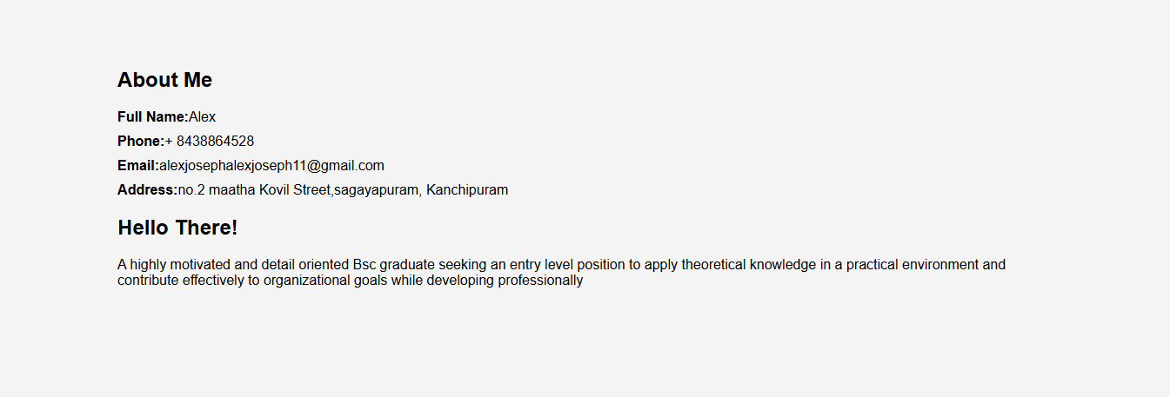

Slide 17
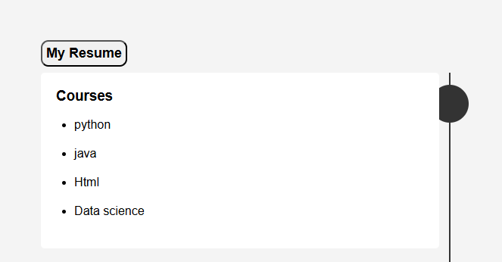

Slide 18
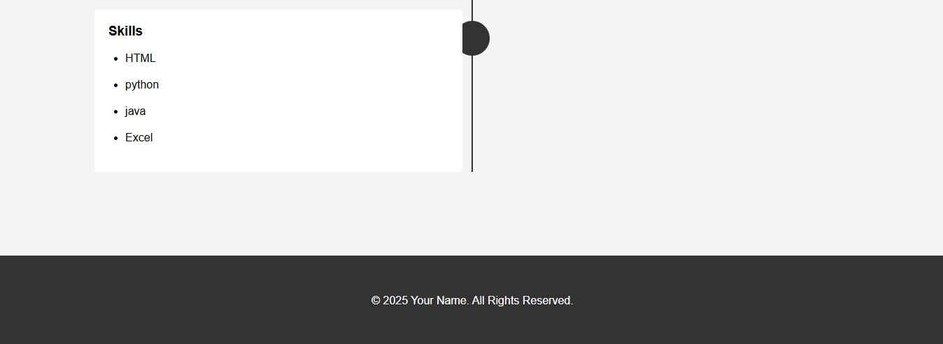

Slide 19
CONCLUSION
Successfully developed a functional, responsive portfolio.
Achieved all initial objectives.
Serves as a practical application of theoretical knowledge.
19

Slide 20
FUTURE ENHANCEMENTS
Integrate a backend for the contact form.
Add a blog section.
Implement multi-language support.
Continuously update with new projects.

Slide 21
GITHUB LINK
Live Website URL: https://alexjosephalex.github.io/Digital_portfolio/.
Source Code Repository: https://github.com/alexjosephalex/Digital_portfolio.git.

Slide 22
THANK YOU
Thank you for your time and attention.
I am now open to questions.

